Slide 1
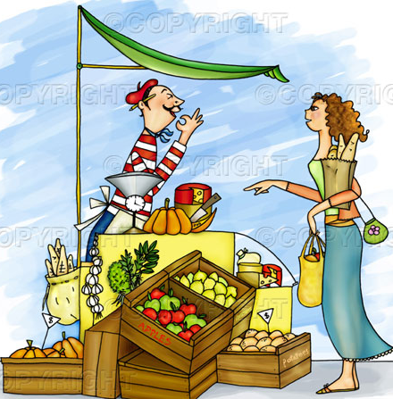
Packing of fruits and vegetables
Dr. Sujatha Weerasinghe

Slide 2
Introduction
Packing fresh commodity is one of the most important step in the long and complicated journey from grower to consumer.
Packing and packing material contribute a significant cost to the fruits and vegetables production industry.
Now let us see why do we need packaging?

Slide 3
Why do we need packing?
Fruits and veg. are perishables
Can protect contaminations
Protect damages
Avoid excess moisture losses

Slide 4
Requirements of packaging
They must be :
Non toxic
Compatible with commodity
Light protection
Gas and odor protection
Cost effective
Convenient to handle
Protect during storage and marketing

Slide 5
There are several types and varieties of packing. Will see what are those
Baskets and natural containers
They made up of bamboo, reeds, coconut and palm leaves, and straw etc.
Easily get contaminated with decaying organisms
Difficult to clean
Not rigid and bend easily
Difficult to stack and transport long distances
Cause pressure damages when tightly filled
Often have sharp edges and cause puncture damages to commodity

Slide 6
Baskets and containers

Slide 7
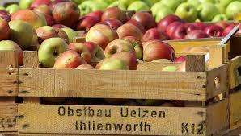
Wood pellets
Wooden structures built as inexpensively and discard after a single use

Slide 8
Wood pellet bins
Primarily use to carry products from fields to packing house
Difficult to stack several bins together for cooling or storage

Slide 10
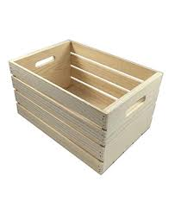
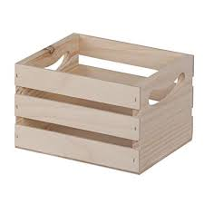
Wooden crates
Can be used for potatoes and Apple

Slide 11
Wooden baskets and hampers
Can use for wide variety of crops
Durable and nested for efficient transport when empty
Reusable for several times
Costly material

Slide 13
Corrugated fire boards
Manufactured in different styles and weights
Cost effective
Cold temperatures and high humidity reduce the strength of the fire board containers
Cabbage, melon, Pumpkin, Potatoes and Citrus can be shipped successfully in the containers

Slide 14
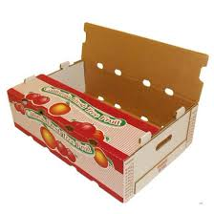
Corrugated fire boards

Slide 15
Pulp containers
Made with recycled paper pulp and starch binder
Available in large varieties of shape and size
Relatively expensive
Can absorb surface moisture from commodities
Bio degradable and recyclable

Slide 16
Pulp containers

Slide 17
Paper and mesh bags
Consumer packs of potatoes and onion
Low cost
Uninhibited air flow and good ventilation
Attractive displays and stimulate purchers
Do not offer protection from rough handling
Little protection from light and contaminants

Slide 18
Paper and mesh bags

Slide 19
Plastic bags / polyethylene films
Predominant consumer packaging for vegetables and fruits
Low cost
Easy inspection of the contents

Slide 20
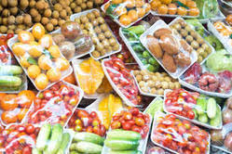
Shrink wrap
Protect the produce from mechanical damages and pathogens
Provide a good surface for stick – on lables

Slide 21
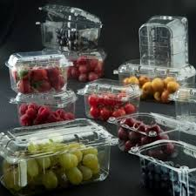
Rigid plastic package
Package with top and bottom
Known as clamshells
Use as consumer packs of high value produce such as Button mushroom, Straw berries

Slide 22
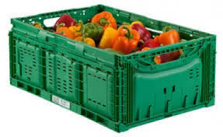
Plastic filled boxes
Made of Polyvinyl chloride or Poly ethylene
Durable and last many years
Empty craters are easy to transport

Slide 23
Now we have studied several types of packages and now let us see the cost effectiveness
Packaging represent an added cost but the price of the market is increased
Losses are significantly reduced
Presentation and quality of the product make more desirable
Marketable life of the produce is extended

Slide 24
Further reading
Broustead, P.J. and New, J.H. 18986. Packing of fruits and vegetables : A study of models for the manufacture of corrugated fireboard boxes in developing countries. London:TDRI, NRI, Central Avenue, Chatham Maritime, Kent, ME4, 4TB, United Kingdom

Slide 25
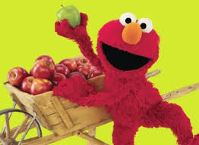
Thank you

