Slide 1
Fruit crop cultivation and management
Dr. Sujatha Weerasinghe

Slide 2
Learning objectives
To introduce the importance of fruit crop cultivation
To explain the present situation of fruit crop sector especially in Sri lanka
To aware on development programs implemented by the government
To introduce the cultivation techniques and management of major fruit crops

Slide 3
Learning outcomes
At the end of this lesson you will be able to explain :
The status of fruit crop sector and its contribution to the economy of Sri Lanka
National programs launched to enhance the fruit productivity
Cultivation technologies of major fruit crop species.

Slide 4
Content
Introduction of fruit crops
Current status of extents , distribution and exports of major fruit species
Area needed the attention
Development programs launched by the government
Policy decisions

Slide 5
Introduction
Let us see what is fruit crop.
Plants that produce plenty of fruits are normally recognized as fruit crops. The fruit plant have become great resources of important nutrients we fulfilled the need for vitamins and fibre by gathering fruits from the wild. Today we are growing various types of fruit plants using advance technologies and tools and referred as fruit crop cultivation

Slide 6
Now let us get on to the fruit crop cultivation in Sri Lanka
There are three major climatic regions as wet, intermediate and dry
The country comprised of 46 different agro climatic zones having diverse fruits and different cropping seasons
Fruit crop cultivation area is about 150,000 ha .
The contribution of the fruit sector to the Gross Domestic Product (GDP) is 0.5%

Slide 7
If we consider the current status of the fruit sector following features can be identified.
There is a vast diversity and have about 250 edible fruit species.
About 90% are home gardens and 10% are commercial cultivations
More than 5% of the cultivations are less than 5 ac.
There are a few medium to large orchards of major fruit crops.
Post harvest losses are 20 – 35 %.
Around 3 – 5 % is exported to Europe, Middle East and Maldives.

Slide 8
Present extents of commonly growing fruit crops - 2017
Crop | Extent (Ha)
Banana | 50,000
Pineapple | 6000
Mango | 16,500
Papaya | 6500
Rambutan | 7500
Passionfruit | 1200
Orange | 4000
Lemon/lime | 3200
Avacado | 1250
Guava | 1700
Pomegranate | 1300

Slide 9
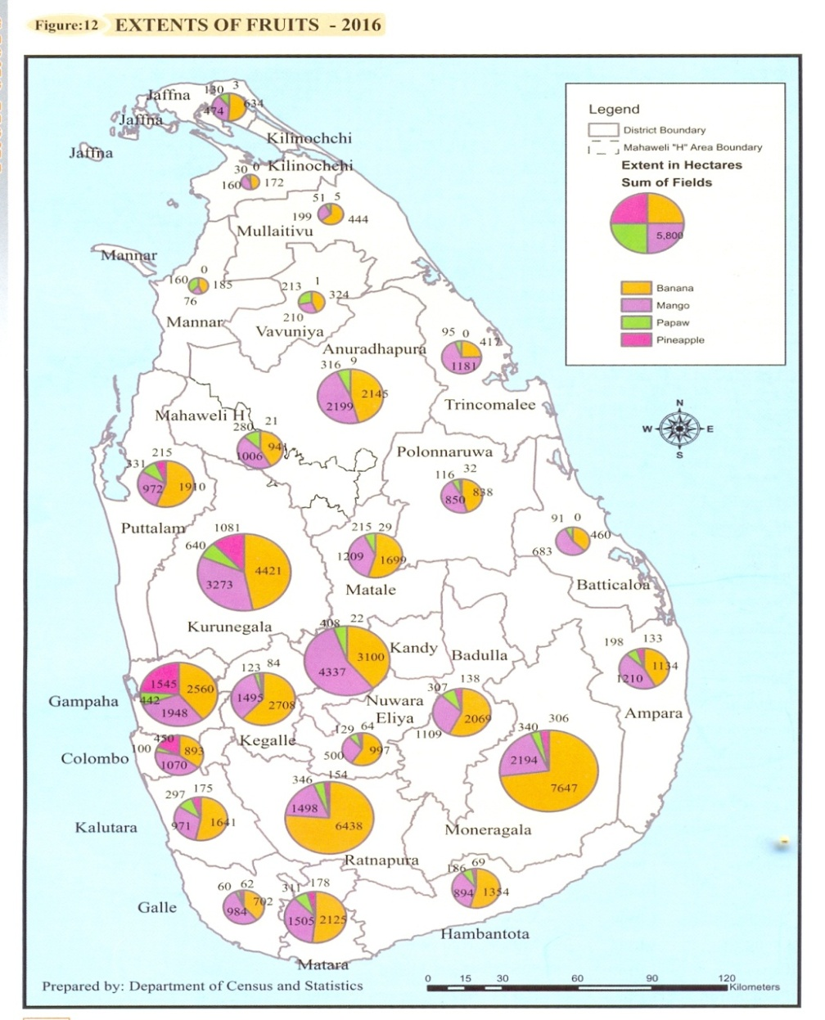
Distribution of major fruit crops

Slide 10
Export of fruit crops-2017
Crop | Exports (Mt)
Banana | 20600
Pineapple | 1500
Mango | 90
Papaya | 3300
Strawberry | 03
Mangosteen | 05
Watermelon | 36
Lemon/lime | 140
Avacado | 14
Guava | 04
Cashew | 63

Slide 11
Major sectors need attention in fruit cultivation
To improve the fruit sector we have to draw attention specially on :
Varietal improvement
Healthy planting material production
Integrated pest and disease management
Integrated plant nutrient management
Modern /improved agronomic aspects
Organic production technologies
Use of machineries
Adaptability to non traditional zones
Postharvest handling and value addition
Production of quality fruits

Slide 12
Quality improvement programs
Island wide fruit tree training and pruning programs - Training of professional pruners provided with pruning tools
Tree rehabilitation / rejuvenation
Area wide integrated fruit fly control programs
Establishment of special unit for practicing Good Agricultural Practices in all districts
Food safety and traceability establishment
Establishment of fruit quality standards

Slide 13
Considering all these aspects the government is launching some programs to promote the fruit industry
Commercial fruit orchards – 50% subsidy
Youth entrepreneur program- 50% subsidy
Entrepreneur cluster villages combine with exporters – 2017
Crop zoning /productivity villages
Extend cultivations to plantation sector – Tea, Rubber and Coconut.
Bio diversity conservation .
Introduction of fruits to non traditional areas
Promotion of off seasonal cultivations

Slide 14
Value chain encouragement
Promotion of on-farm agro-tourism
Promotion of fruit consumption through schools
Promotion of national fruit consumption – 200g/day
Fruit clinics, consultations and technical solutions
Soil testing programmes

Slide 15
Establishment of cottage level fruit processing units.
Dissemination of information through mass media/booklets
Free information transformation service – 1920 – Govi sarana sevaya
Introduction of “ Govi mithuru sevaya” with Dialogue company
E- Extension promotion

Slide 16
Government policy trends
Strengthening of National Plant Quarantine system
Especial food production drive
Adopting European standards
Minimizing use of agro-chemicals –GAP
Ban on selected agro chemicals
Pest risk analysis on exports
Bi lateral and multi lateral agreements ( China, India, Pakistan, Nigeria, Thailand etc.)

Slide 17
With …
All these projects, programs and policy decisions government is attempting to promote the fruit industry in Sri lanka.

Slide 18
Now let us get on to the general information about fruits
Generally fruits are categorized in to different groups depending on their consumption.
Major fruits -
- year round production
- grown in all parts of the country
- consumption is very high
Commonly growing fruits -
- grown commonly
- production is seasonal
Underutilized or under developed fruits
- naturally grown
- less attention has been paid
- consumption is low

Slide 19
In addition to this categorization…
There is a special category of fruit referred as SUPERFRUITS.
Super fruits contain unique compounds such as high quantities of antioxidants, polysaccharides, vitamins, fiber, species specific phyto nutrients and adaptogens ( non toxic chemicals that help to resist plant for stress conditions) .

Slide 20
Superfruits are……
Naturally grown in remote arid regions and tropical rain forests.
Many superfruits are not as sweet in taste.
With higher levels of enzymes, polyphenols and antioxidents
Often not available as fresh fruits
Most of the underutilized fruits in Sri Lanka could be considered as super fruits.

Slide 21
Some examples for super fruits are:
Acai berry in Brazillian Amazone region
Amala berry or Indian Goose berry in India
Barbadose cherry in Central America.
Durian, Longan fruit (Mora or Dragon eye), Mangosteen in Sri lanka.
Therefore most of the underutilized fruits in Sri Lanka are nutritive and could be considered as super fruits.

Slide 22
Now we know the present status of the fruit sector in Sri lanka and basic information about fruits.
Therefore, let us study the production and management of some important frit species explained in videos.

Slide 23
Thankyou

