Slide 1
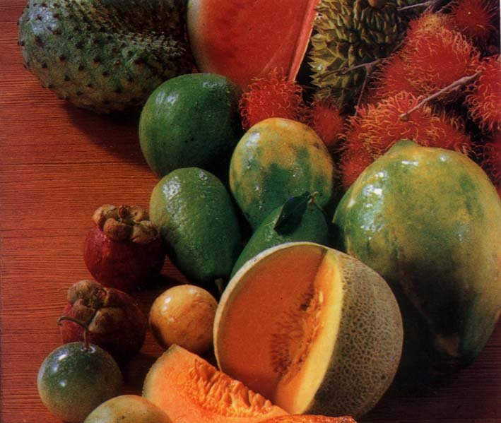
Fruit Ripening

Slide 2
Learning objectives
To introduce fruit categories depending on their nature of ripening
To explain the involvement of ethylene in fruit ripening
To introduce artificial fruit ripening techniques

Slide 3
Learning outcomes
At the end of this lesson you will be able to explain:
Categorization of fruits depending on the nature ripening .
Involvement of ethylene in fruit ripening
Advantages and disadvantages of artificial fruit ripening
Methods and factors to be considered in artificial fruit ripening

Slide 4
Fruit ripening
Caused by a naturally producing chemical by all plant parts known as Ethylene – C₂ H₄
Let us see how does ethylene produced within fruits. There is a specific procedure to generate ethylene known as " Ethylene biosynthesis". Therefore, it is important to understand the pathway of production of ethylene.

Slide 5
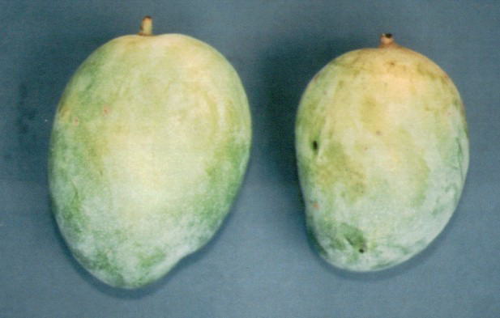
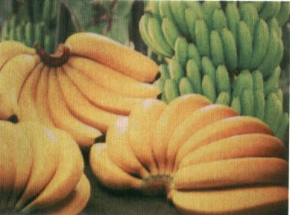
Bio synthesis of ethylene
Methionin (Immature fruits) Polyamine
(Mature fruits)
Ethylene
Methionin
SAM (S- adynosil methionin)
Acc synthase
ACC ( Adynocyl chloropropane – 1- carboxylic acid)
C2H4 ( Acc Oxydase + oxygen )

Slide 6
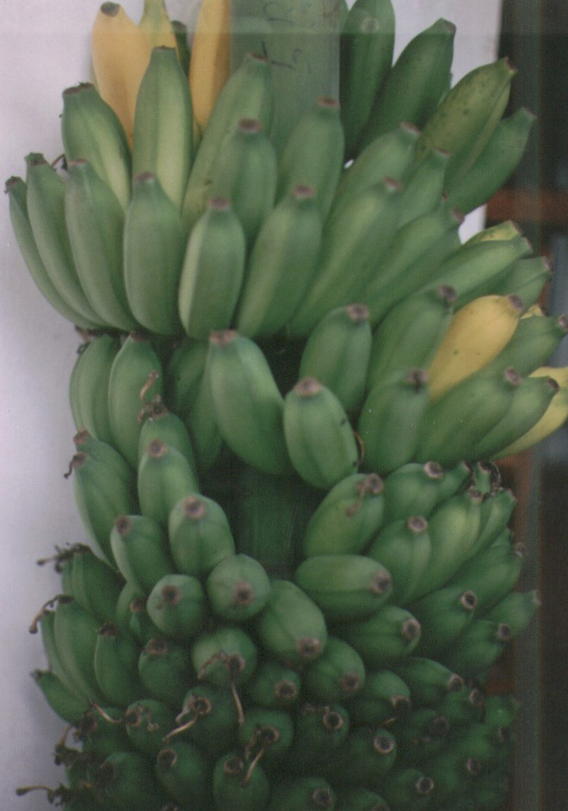
Methionin
SAM
Acc synthase
ACC
C2H4
Accumulated at threshold level (1ppm)
Produce more and more ethylene which is termed as autocatalytic ethylene production
Once this happened cannot be stopped
ACC oxydase

Slide 7
According to the nature of fruit ripening there are two major catagories.
Climacteric fruits
Non climacteric fruits
There are several differences between these two groups. Let us consider only the main differces.

Slide 8
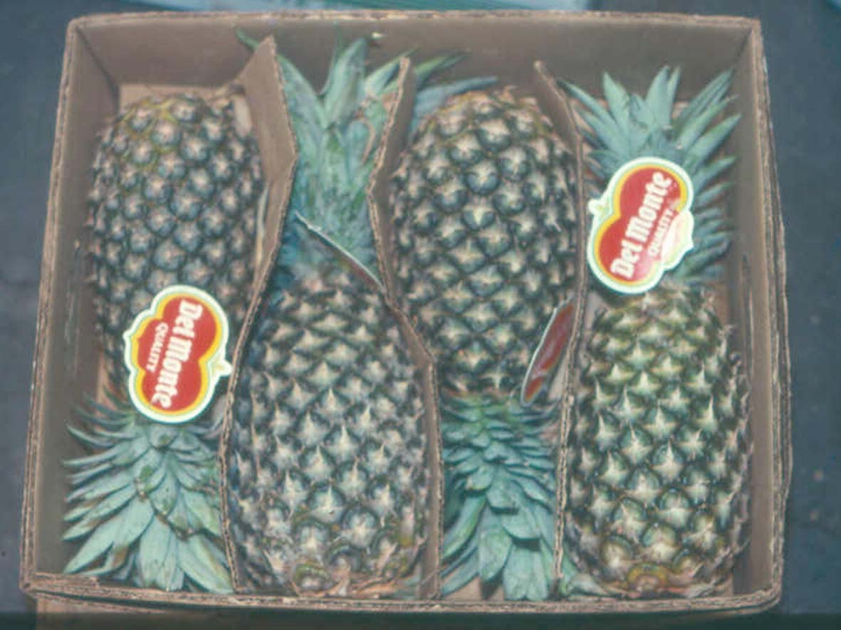
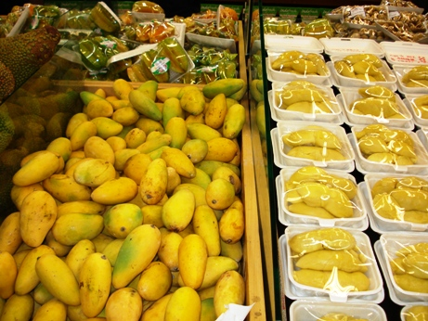
Climacteric Non-climacteric
Ripening after harvest No ripening after harvest
High ethylene production Very low ethylene production
High respiration Low respiration
Mango, banana, avocado Citrus, wood apple, beli, pineapple
Papaya, Durian, Jak fruit rambutan, mangosteen, guava
Exposure to 100 ppm ethylene induce autocatalytic ethylene production
Once induce the ethylene production cannot be stopped

Slide 9
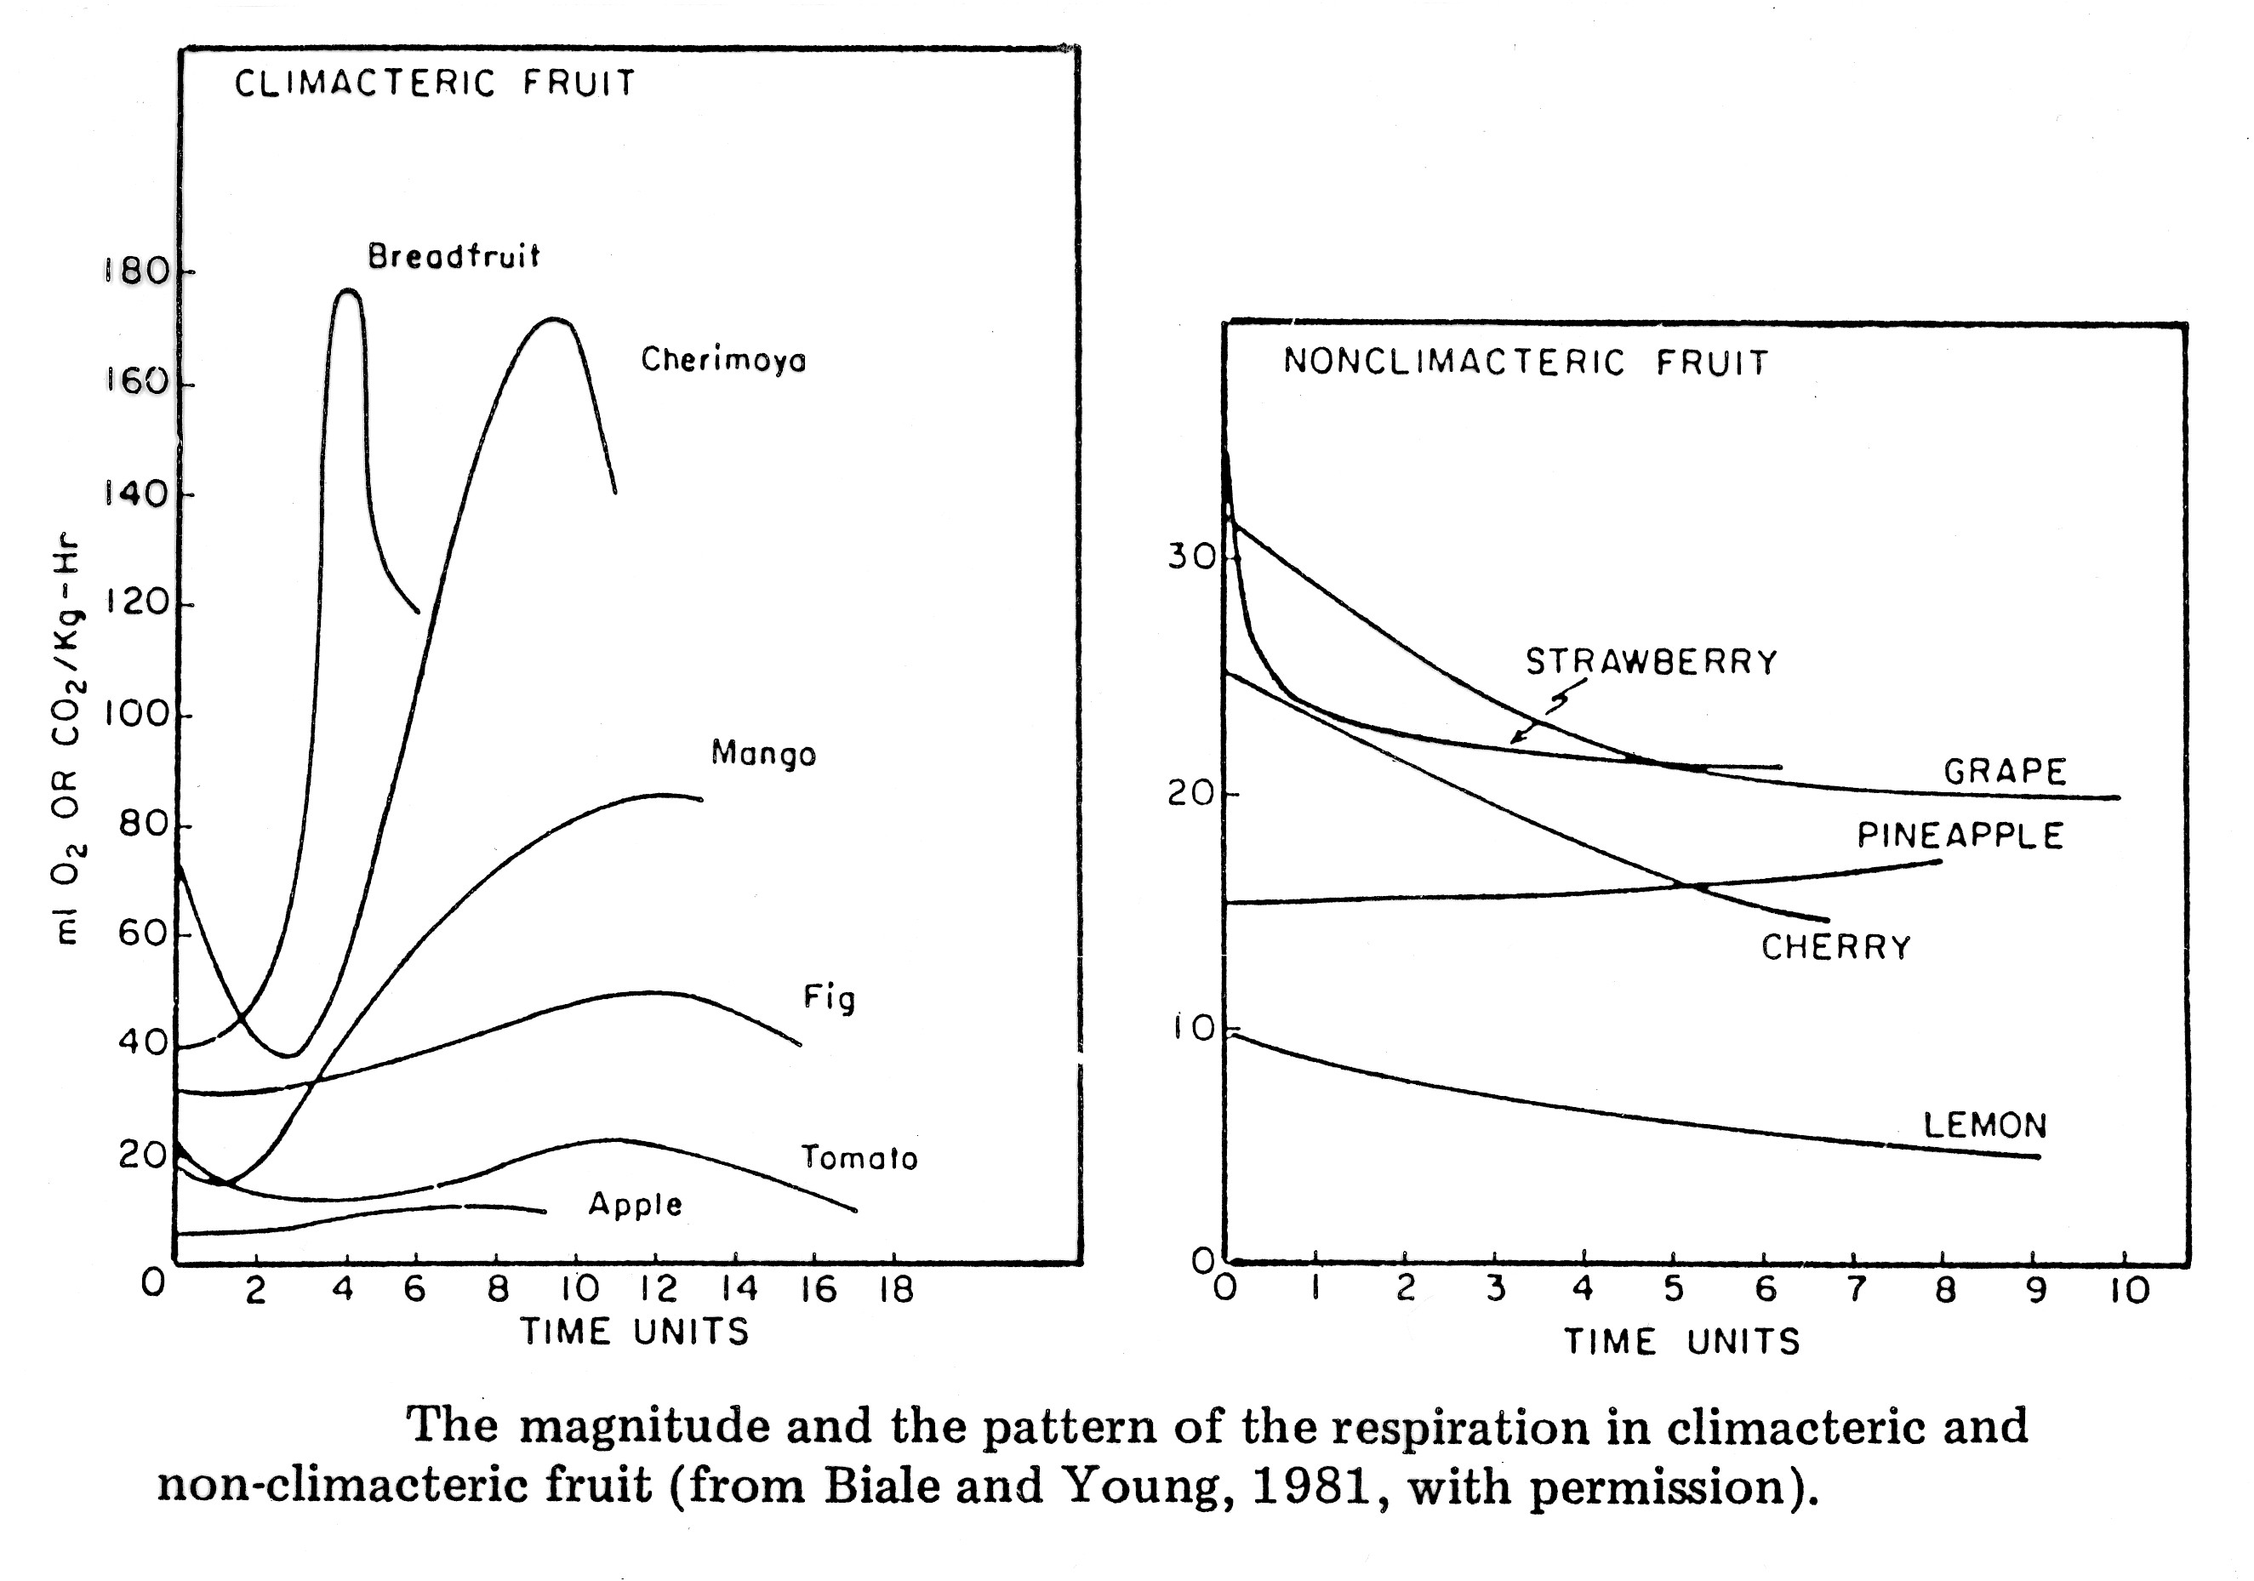
Changes of respiration in different species of Climacteric and non-climacteric fruits
respiration
respiration

Slide 10
Climacteric fruits can be subjected for artificial fruit ripening
There are several natural and chemical methods. However, chemical application is the commonly practicing method. Therefore ,let us consider the methods of artificial fruit ripening in detail.

Slide 11
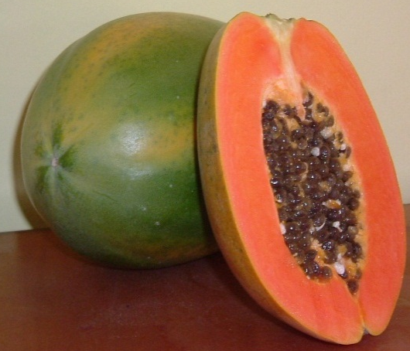
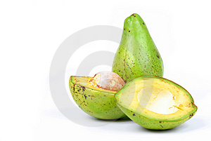
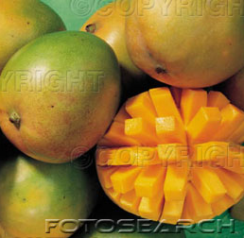
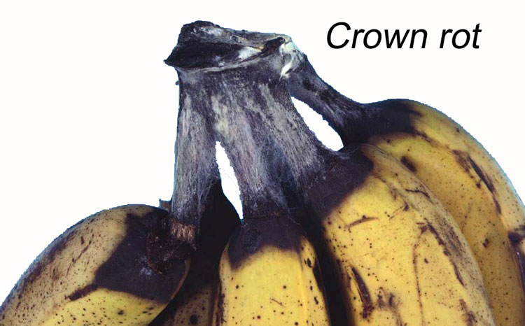
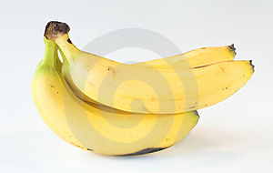
Do we need artificial ripening?
Problems related to natural ripening
Relatively longer duration for ripening
Higher moisture loss
External appearance can be poor
Higher level of postharvest diseases
Eventually higher postharvest loss
Program ripening is not possible

Slide 12
Methods of artificial ripening
Ethylene gas (not available)
Smoking
Wilted leaves
Calcium carbide
Ethral (2-Chloroethyl-phosphonic acid)
Bio ethylene
Ethral
Very cheap source of ethylene
Freely available
No toxic effect

Slide 13
Commonly using chemical of ethyral can be applied in following method.
Ethral Ethylene
pH 3.5 pH 5.5<
Method of application:
Dipping and spraying ??(Possibility of having contaminants)
Gaseous form
Method to evolve gas
1 ml Ethral / L water 3 – 5 ml / ft³
10g Lime / L water 3 – 5 ml /ft³

Slide 14
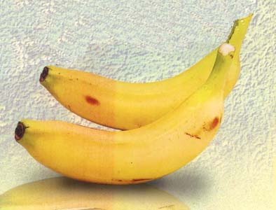
Commercial use
6 Volume: 5 X 5 X 6 = ft³150
Diluted Ethral: ml 600 Lime: ml 600
5
5
Place Ethral in a container
Pack fruits in the container
Pour lime on to Ethral
Leave the system close for 24 h and then ventilate
Fruits will ready to eat within another 3 to 4 days time

Slide 15
Commonly using another chemical is Calcium Carbide. However this chemical should be applied strictly following the correct technique. There is a chemical reaction taken place as follows. CaC₂ + H₂O C₂H₂ + CaO. This released acetylene response similar to that of ethylene and cause ripening.
Carbide is a byproduct of kilns
Possibility of containing
*Arsenic hydride
* Phosphorous hydride
Danger: These chemicals are fat soluble
If carefully used chemical contaminants can be avoided

Slide 16
Disadvantages of carbide
Chemical contaminants
Strong odour
Highly exothermic reaction
Ripened immature fruits- poor flavour
Can be explosive

Slide 17
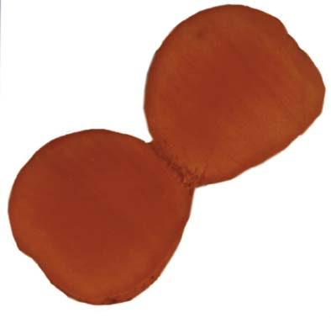
Artificially ripened fruits are less tasty. In natural ripening it starts from inside to outwards. But in artificial ripening it happens from outside towards inside.
Natural Artificial
Stage of ripening is determined by the peel colour
If another day is given develop the same quality

Slide 18
Tips on artificial ripening
Should involve only induction
Provide only threshold level
Ripening due to autocatalytic ethylene production
Must select mature fruits

Slide 19
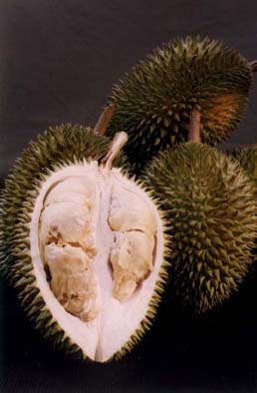
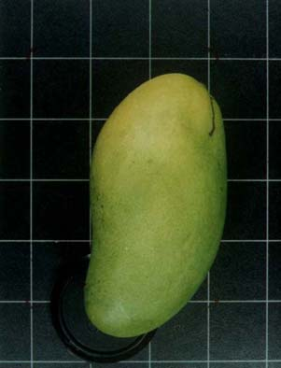
Misused ripening
Green pineapple to change peel colour
Immature mango
Immature durian
Immature lime
Green mature papaya
Green mature passion fruit

Slide 20
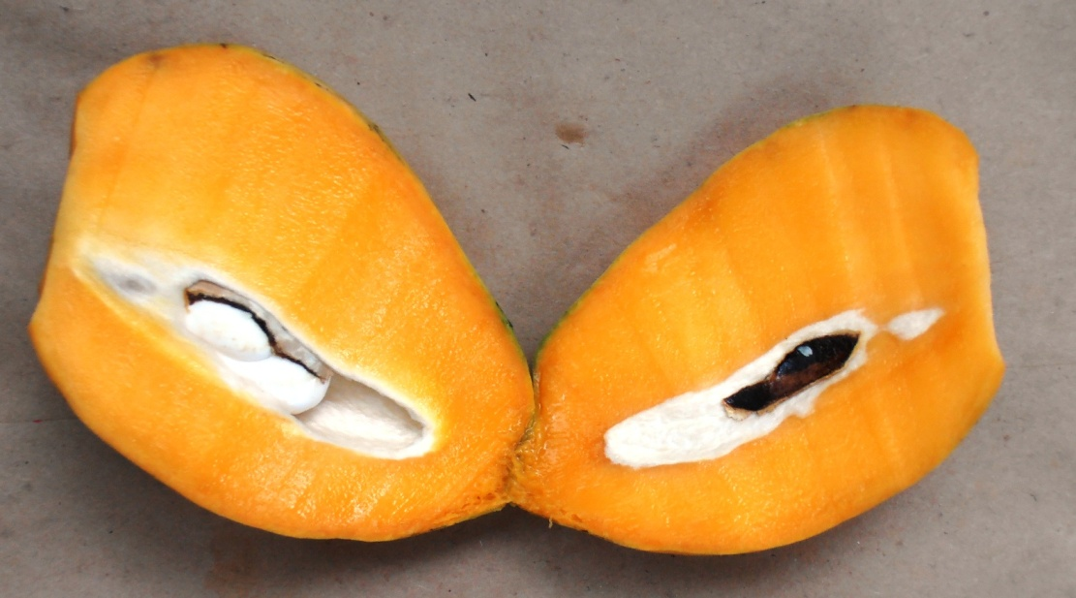
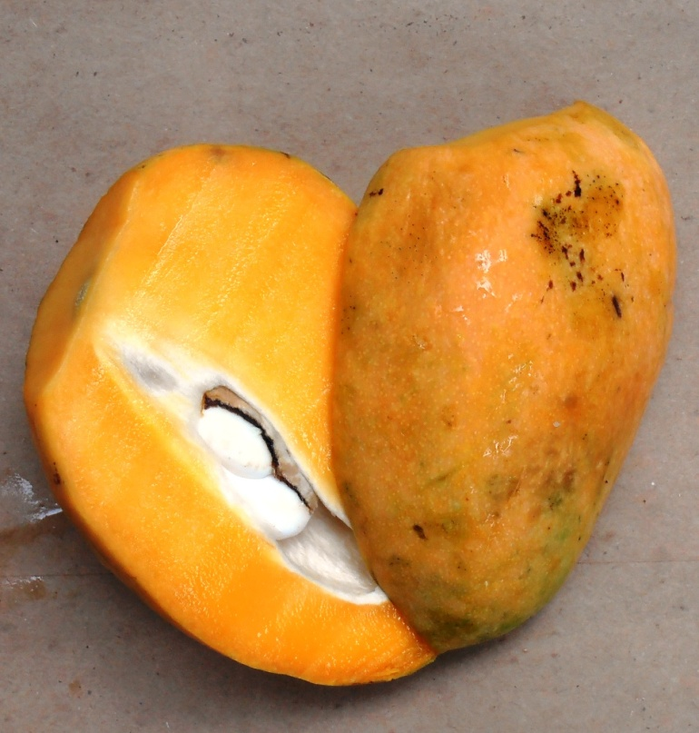
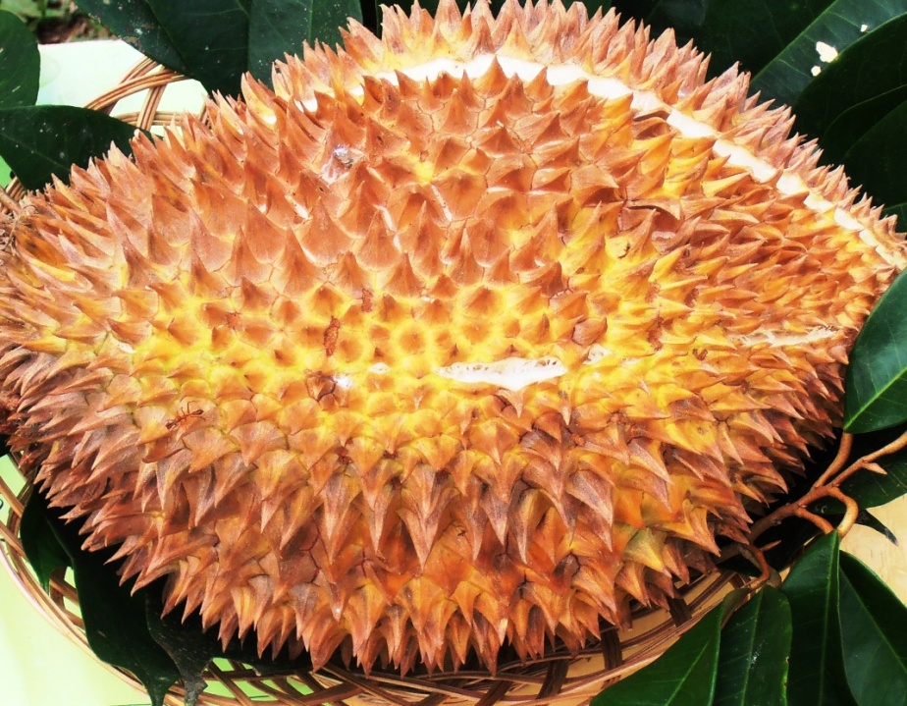

Slide 21
Therefore,
In artificial fruit ripening we must select mature fruits and adopt appropriate methods.
Summary
Fruit ripening induces with autocatalytic ethylene
According to the nature of ripening there are two types as Climacteric and Non climacteric fruits
Fruits harvested at only at the correct maturity stage are suitable for artificial ripening . When we use immature fruits for artificial ripening the quality is utterly degraded.

Slide 22
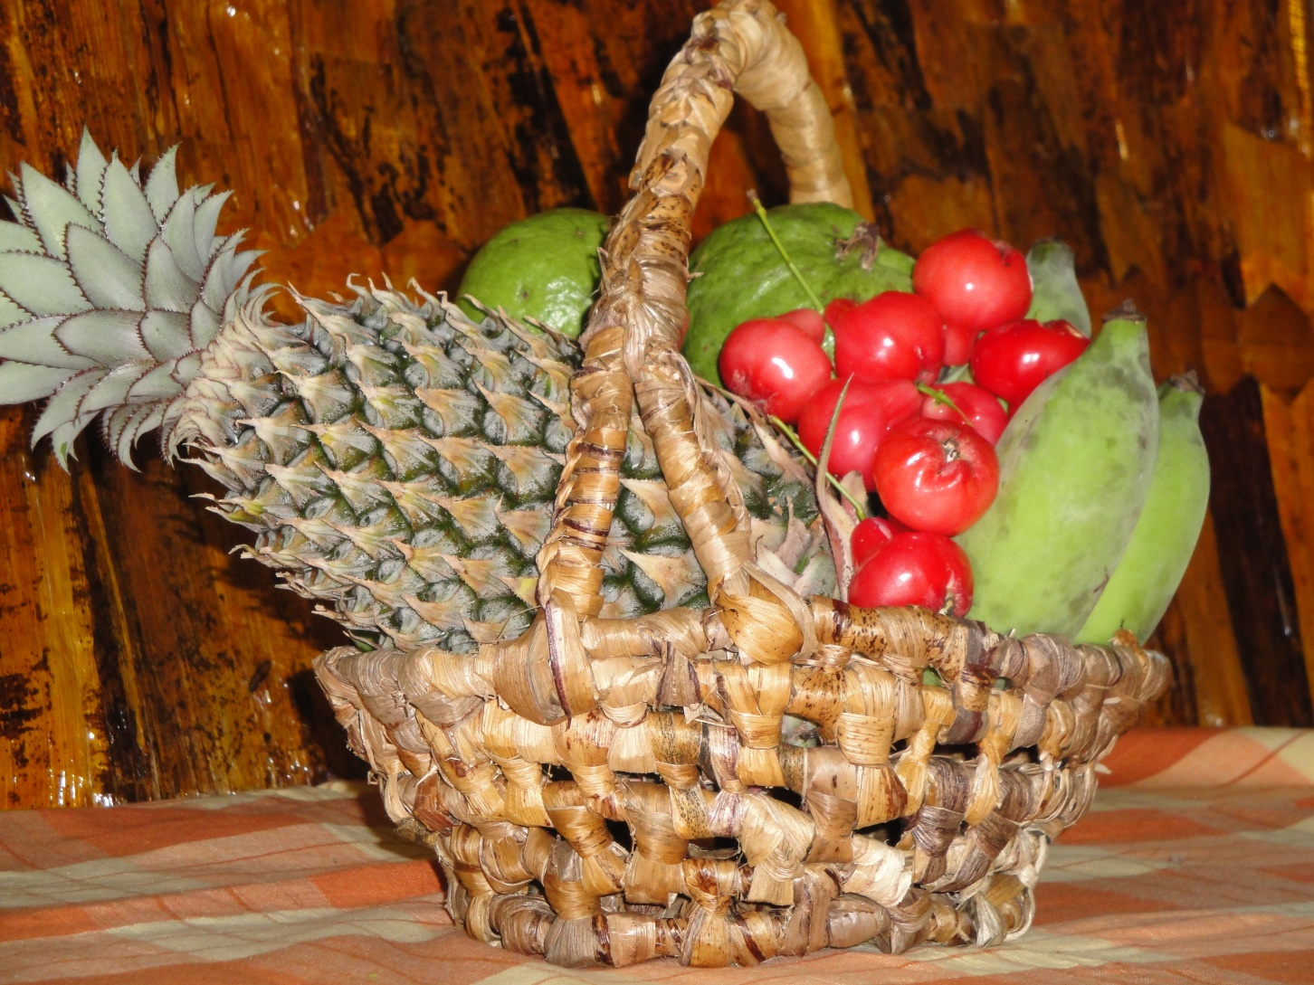
Thank You

